Slide 1
Topic:
Air Quality Data
Analysis and Visualization
Comprehensive Analysis of
Air Quality Metrics
Name: Ritik Malviya
Last Of Submission: 24/06/2024

Slide 2
Introduction
Objective:
To analyze and visualize air quality data.
Preprocess the dataset to handle missing values and format data.
Conduct Exploratory Data Analysis (EDA) to gain insights into the dataset.
Create visualizations to illustrate key findings and relationships among variables
Data Source:
The dataset used in this analysis is the Air Quality UCI Dataset, which contains air quality measurements from a specific region.
The dataset includes various metrics such as CO levels, benzene concentration, nitrogen oxides, and meteorological variables like temperature and humidity.

Slide 3
Data Preprocessing
Loading the Data
The data is loaded from an Excel file using the `pandas` library.
Code:
import pandas as pd
import matplotlib.pyplot as plt
import seaborn as sns
Loading Data
df = pd.read_excel('/content/AirQualityUCI.xlsx')

Slide 4
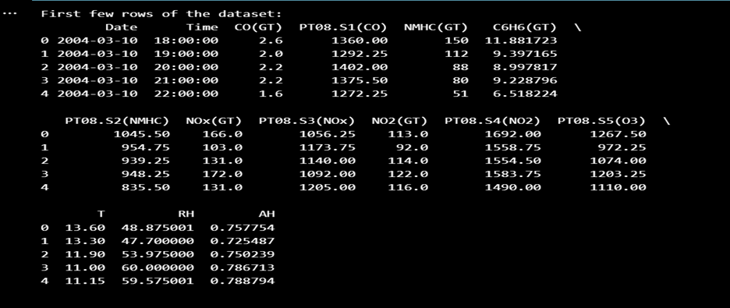
Initial Data Inspection
The first few rows of the dataset were displayed to understand the structure and content of the data.
Code:
print("First few rows of the dataset:")
print(df.head())

Slide 5
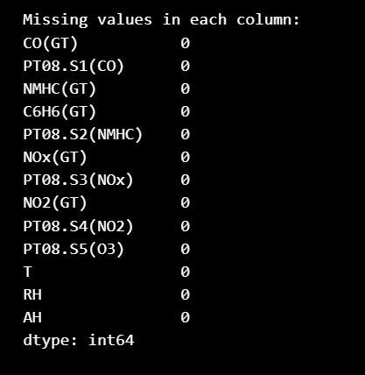
Handling Missing Values
The dataset was checked for missing values. Any missing values in numeric columns were filled with the median of the respective columns.
Code:
# Check for missing values
print("\nMissing values in each column:")
print(df.isnull().sum())
# Fill missing values with the median of each
column (numeric columns only)
numeric_columns = df.select_dtypes
(include=['float64', 'int64']).columns
df[numeric_columns] = df[numeric_columns].
fillna(df[numeric_columns].median())

Slide 6
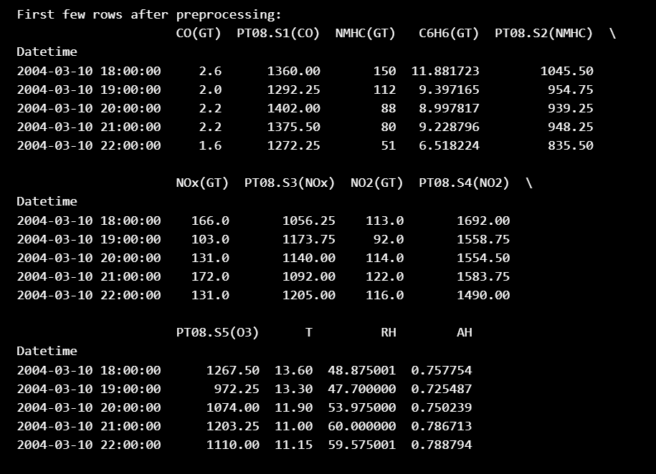
Post-Processing Inspection
# The first few rows of the dataset after preprocessing were displayed to verify the changes.
Code:
print("\nFirst few rows after preprocessing:")
print(df.head())

Slide 7
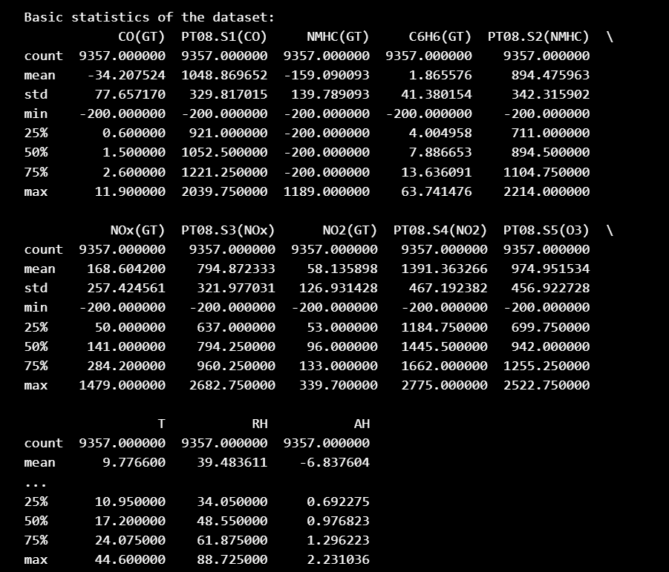
Exploratory Data Analysis (EDA)
# Basic Statistics: Descriptive statistics
were computed to provide a summary
of the dataset.
Code:
print("\nBasic statistics of the dataset:")
print(df.describe())

Slide 8
Histograms
# Histograms for each numeric column were plotted to understand the distribution of values.
Code:
print("\nPlotting histograms for each column...")
df.hist(bins=30, figsize=(20, 15))
plt.tight_layout()
plt.show()

Slide 9
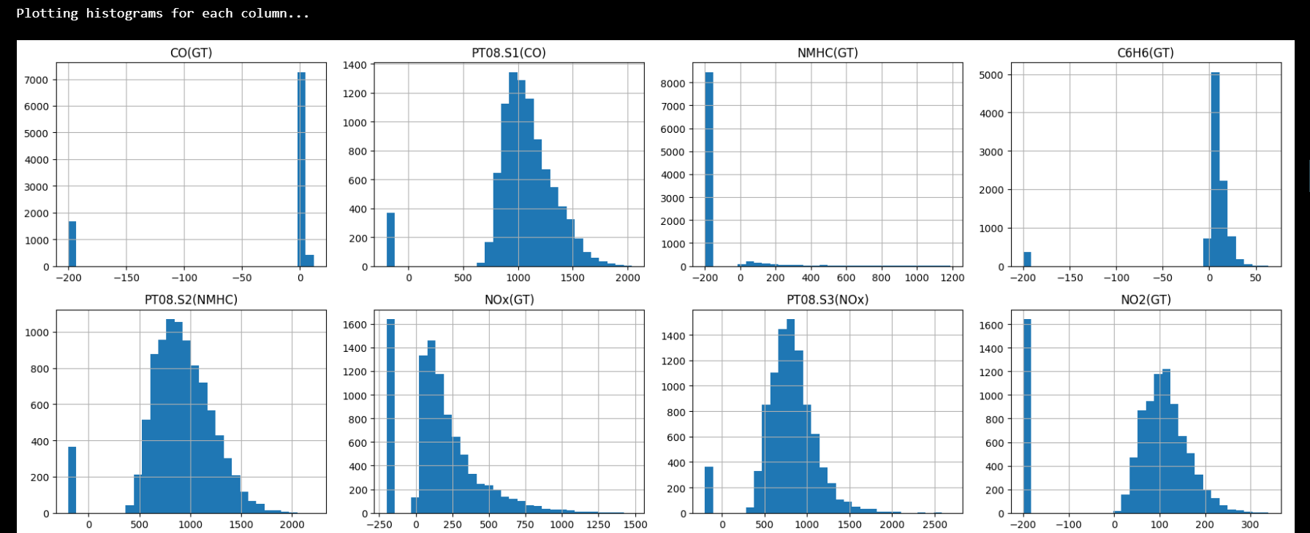
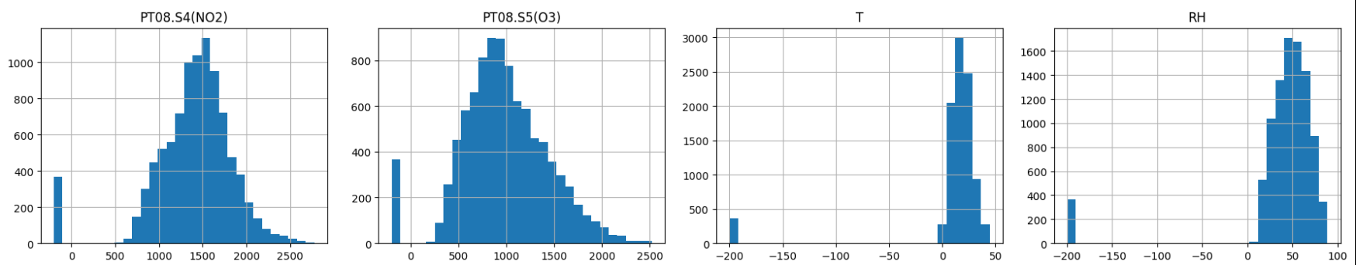
Histograms

Slide 10
Correlation Heatmap
# A heatmap of the correlation matrix was plotted to identify relationships between different variables.
Code:
print("\nPlotting correlation heatmap...")
plt.figure(figsize=(12, 10))
sns.heatmap(df.corr(), annot=True, fmt='.2f', cmap='coolwarm')
plt.show()

Slide 11
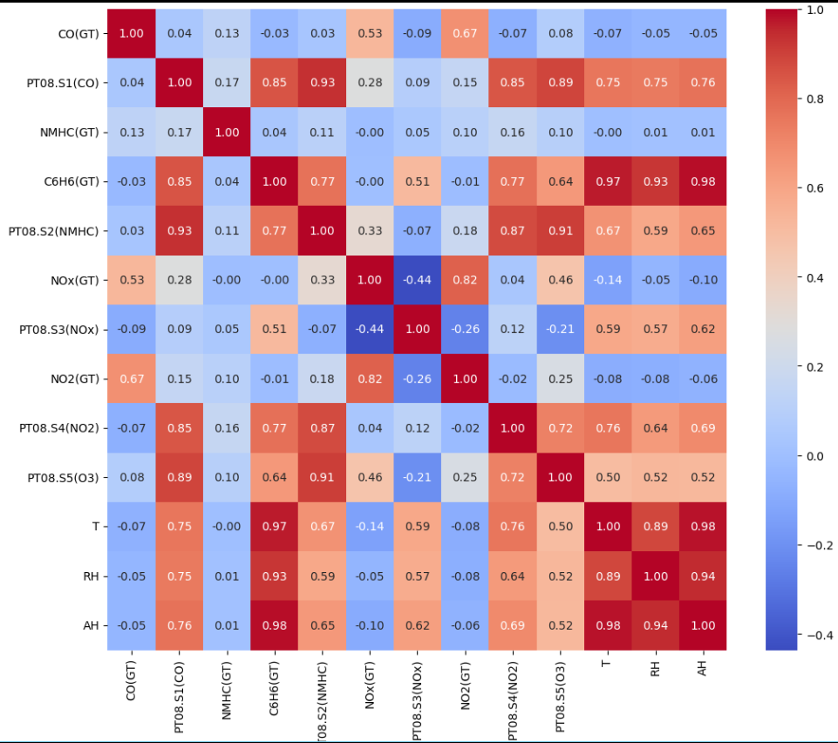
Correlation Heatmap

Slide 12
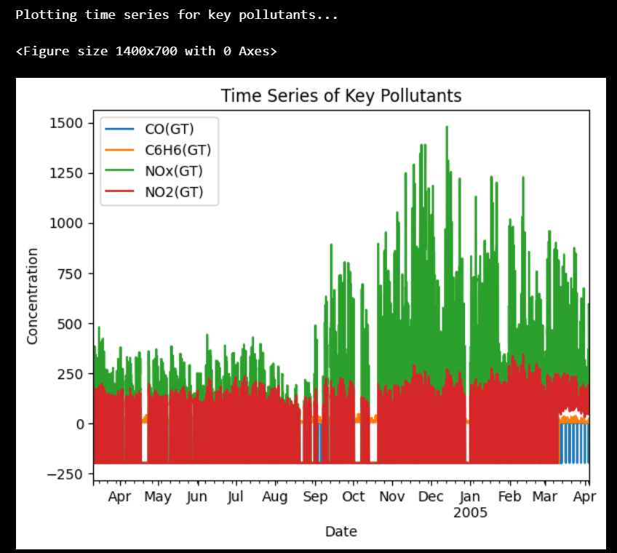
Data Visualization
Time Series Plot
# A time series plot was created to visualize
the trends of key pollutants over time.
Code:
print("\nPlotting time series for key pollutants...")
plt.figure(figsize=(14, 7))
df[['CO(GT)', 'C6H6(GT)', 'NOx(GT)', 'NO2(GT)’]].
plot()
plt.title('Time Series of Key Pollutants')
plt.xlabel('Date')
plt.ylabel('Concentration')
plt.legend()
plt.show()

Slide 13
Monthly Analysis
The CO(GT) levels were analyzed on a monthly basis using different types of plots.
Line Plot
A line plot was created to show the average CO(GT) levels for each month.
Code:
print("\nPlotting line plot for monthly average CO(GT) levels...")
monthly_avg = df['CO(GT)'].resample('M').mean()
plt.figure(figsize=(12, 6))
plt.plot(monthly_avg.index, monthly_avg.values, marker='o')
plt.title('Monthly Average CO(GT) Levels')
plt.xlabel('Month')
plt.ylabel('Average CO(GT)')
plt.grid(True)
plt.show()

Slide 14
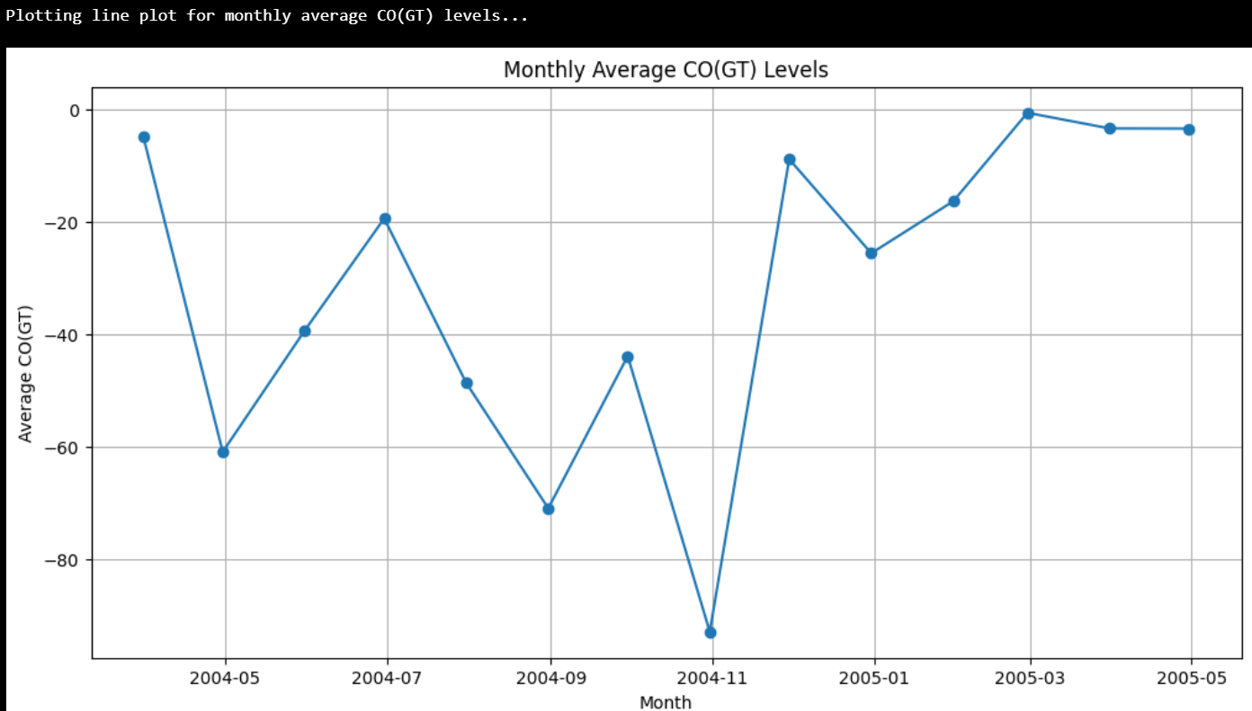

Slide 15
Thank You

